Slide 1
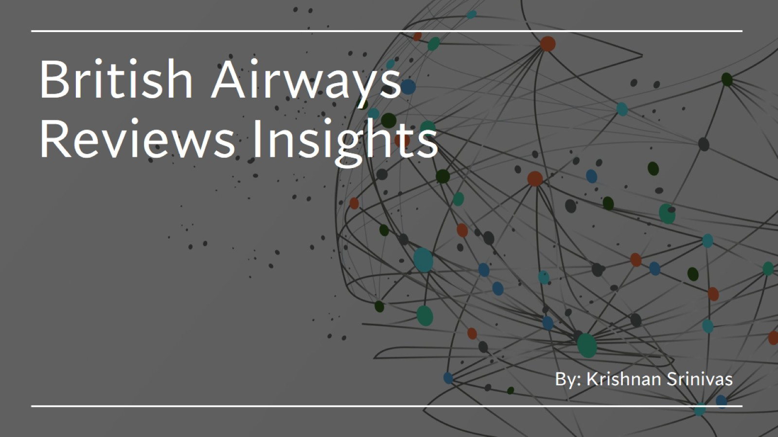
British Airways Reviews Insights

Slide 2
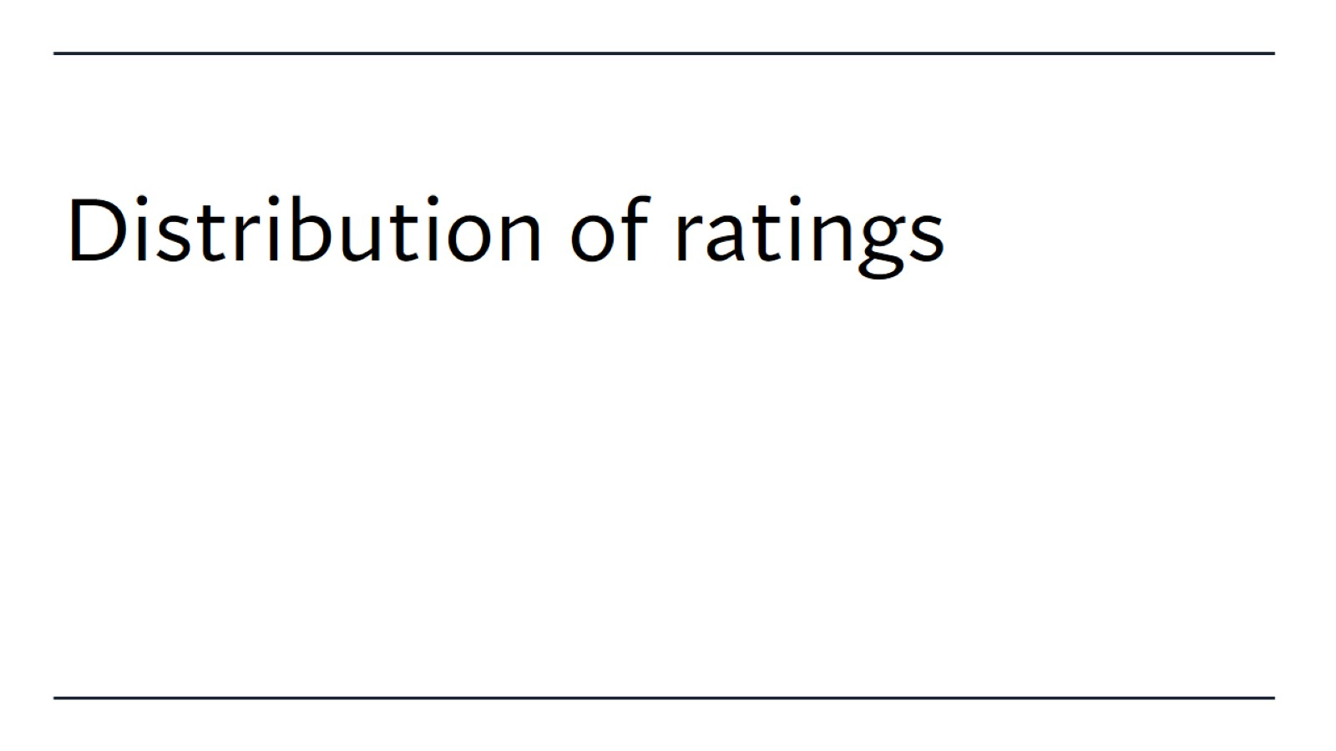
Distribution of ratings

